Slide 1
Aspirin, metformin, statin
Aspirin, metformin, statin vs any drug
Metformin vs any drug persistence 30
Aspirin , statin vs DM med under DM

Slide 2
Aspirin, metformin, statin vs any drug
High correlation no

Slide 3
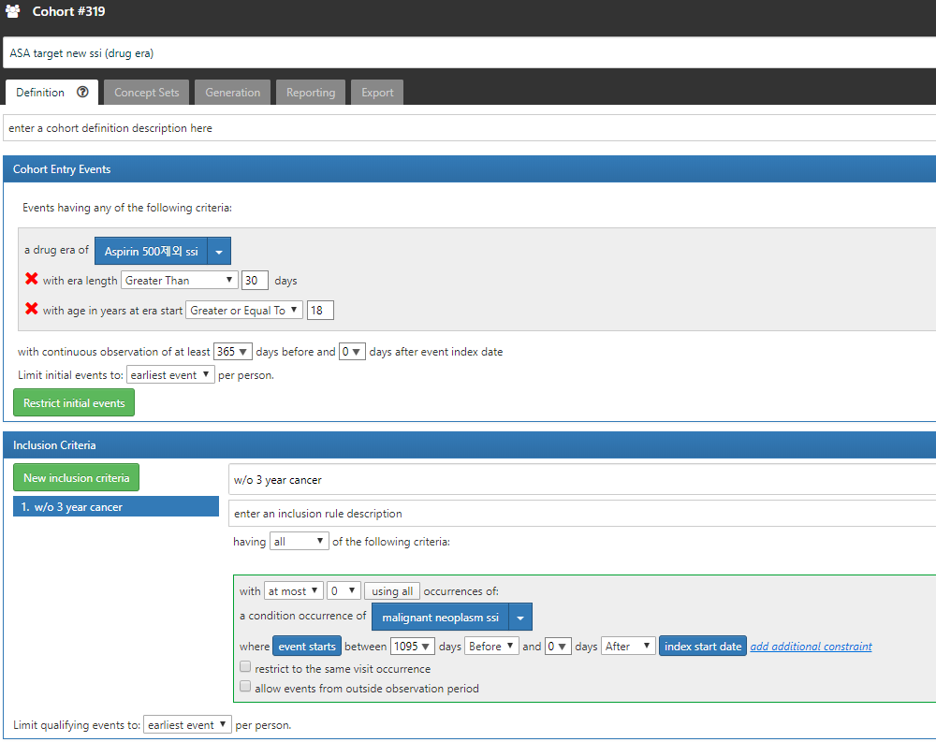
Target cohort

Slide 4
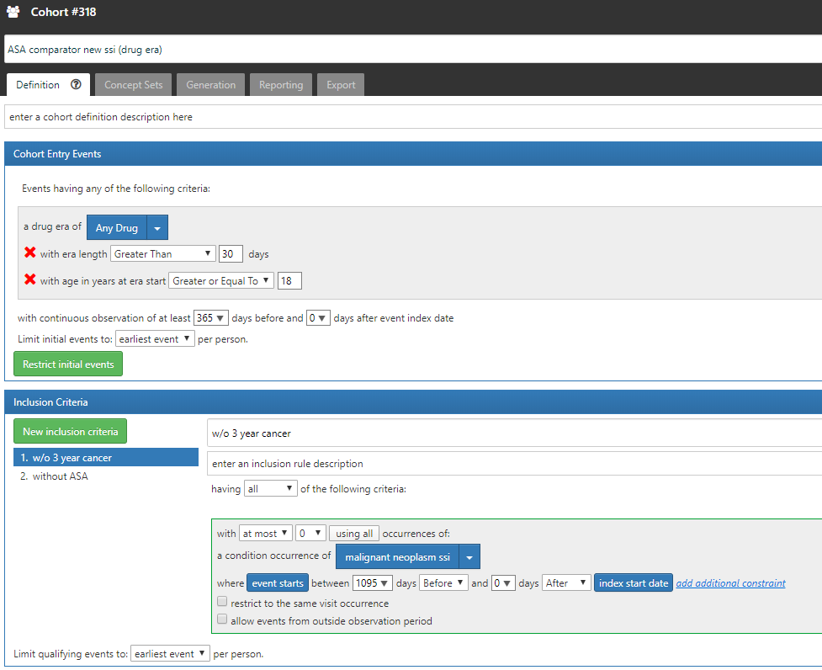
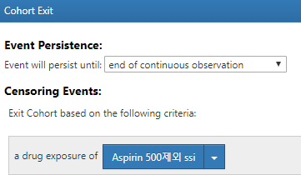
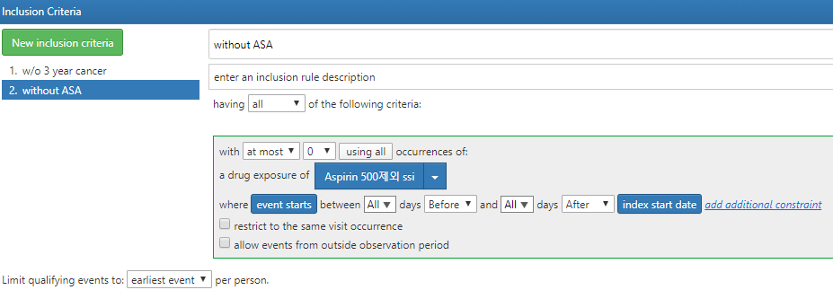
Comparator cohort

Slide 5
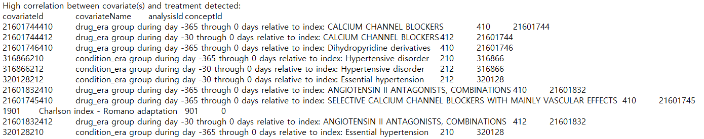
Aspirin 결과
High correlation error

Slide 6
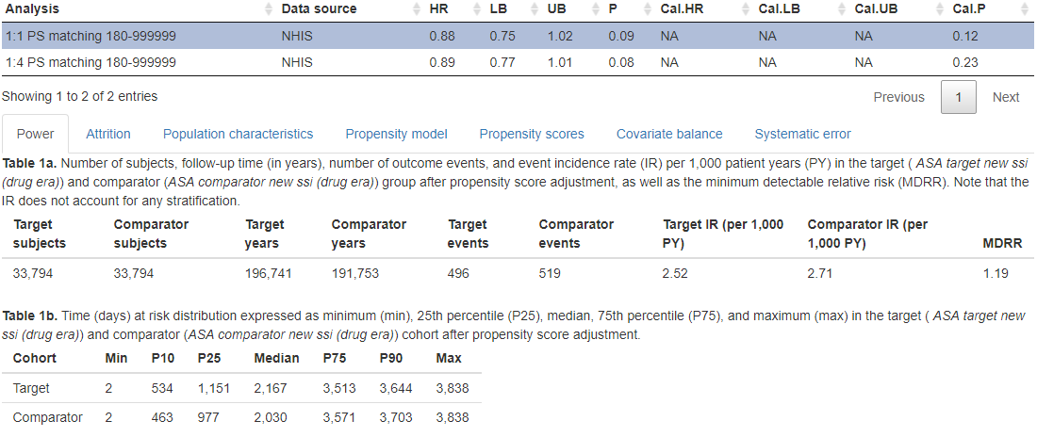
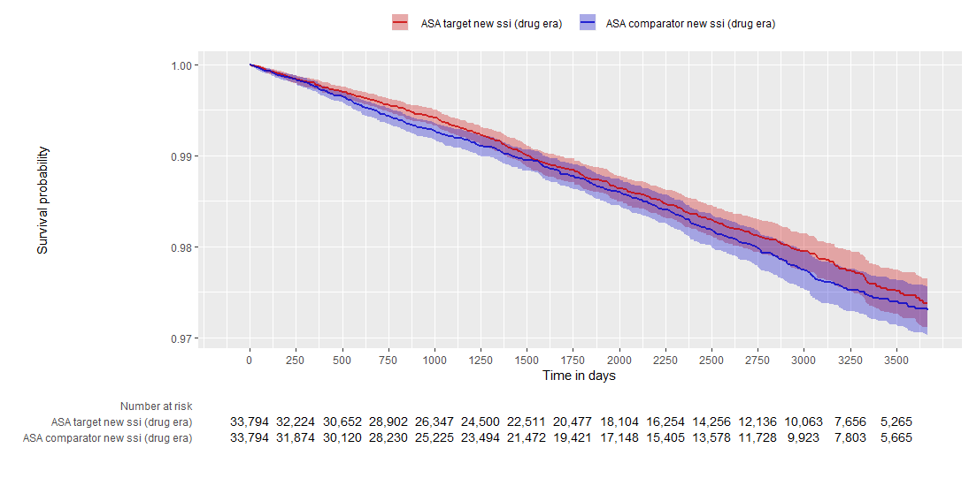
Aspirin 결과 – stomach

Slide 7
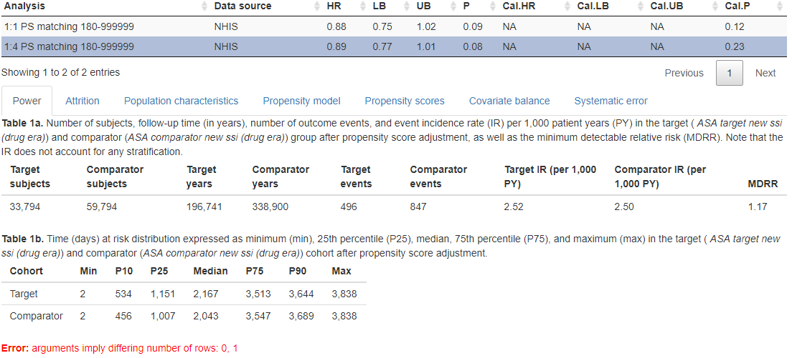
Aspirin 결과 – stomach

Slide 8
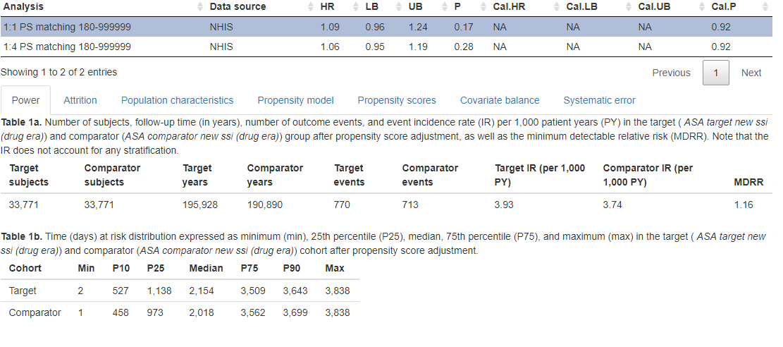
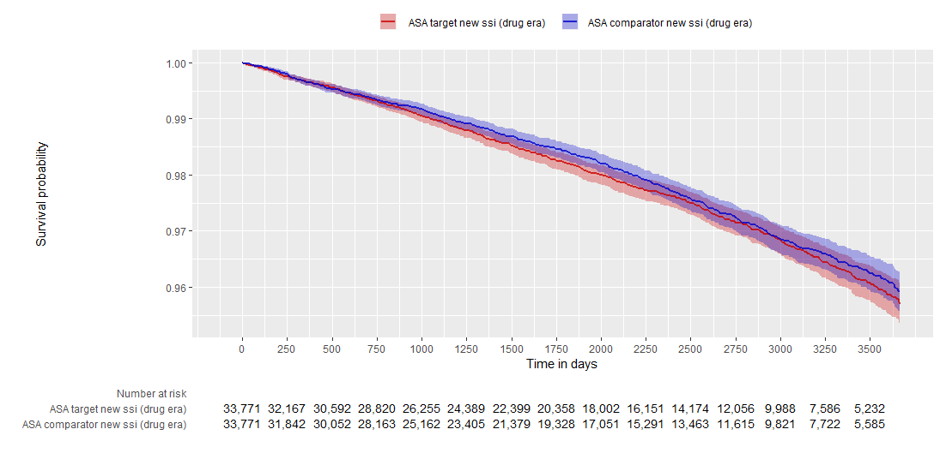
Aspirin 결과 – colon

Slide 9
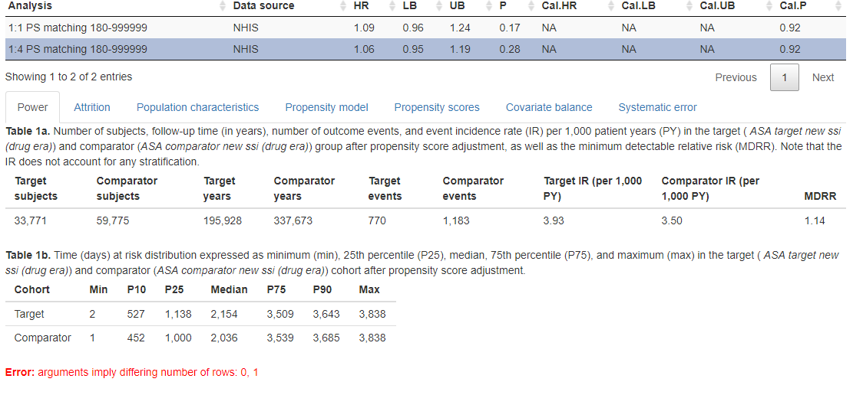
Aspirin 결과 – colon

Slide 10
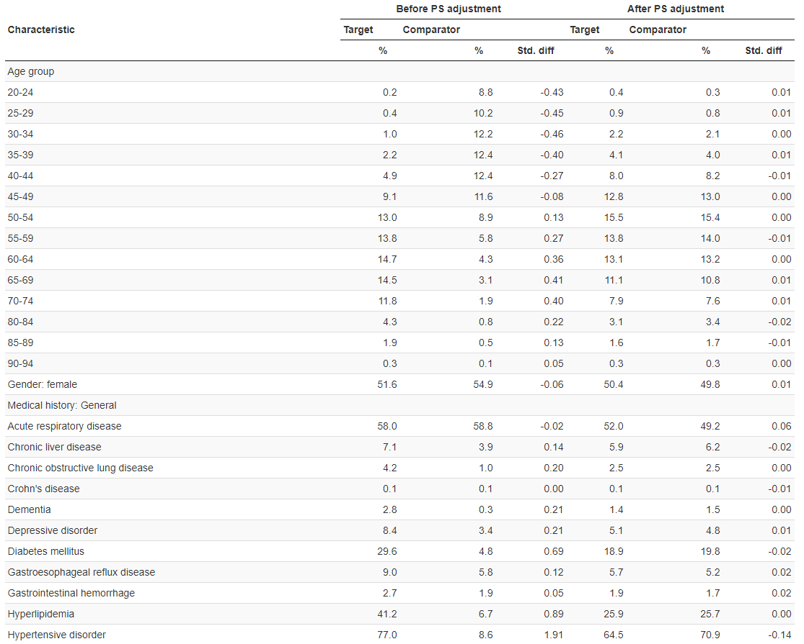
Population characteristics(stomach)

Slide 11
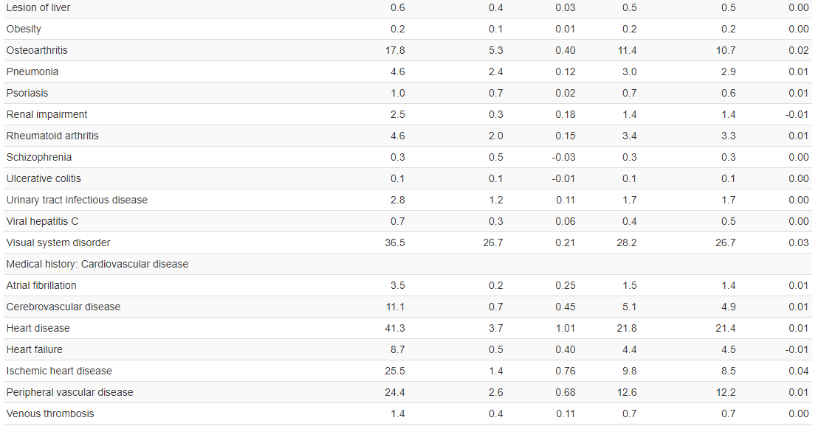
Population characteristics(stomach)

Slide 12
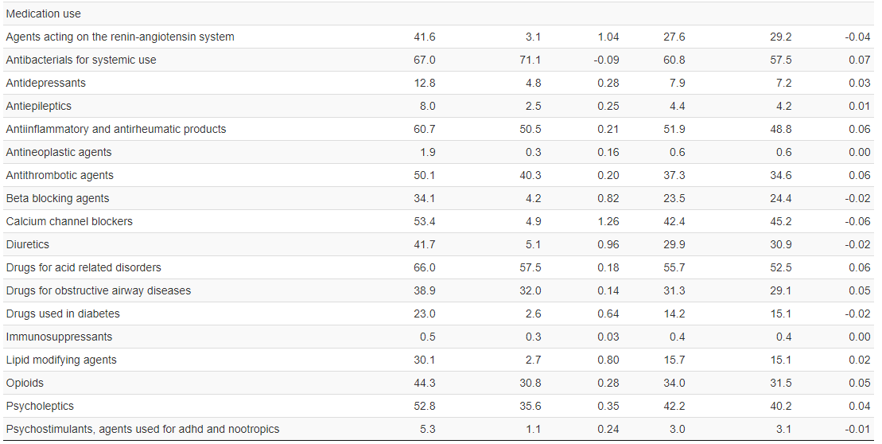
Population characteristics(stomach)

Slide 13
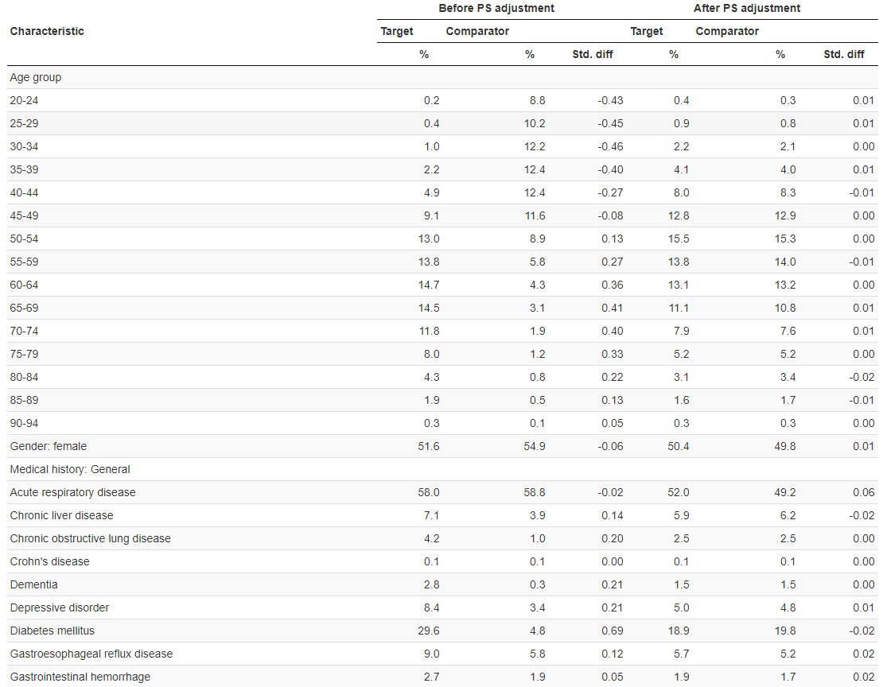
Population characteristics(colon)

Slide 14
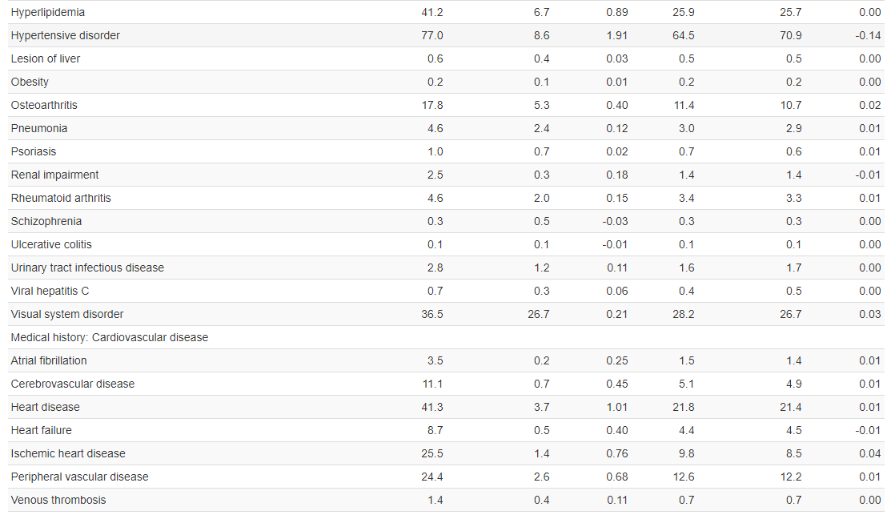
Population characteristics(colon)

Slide 15
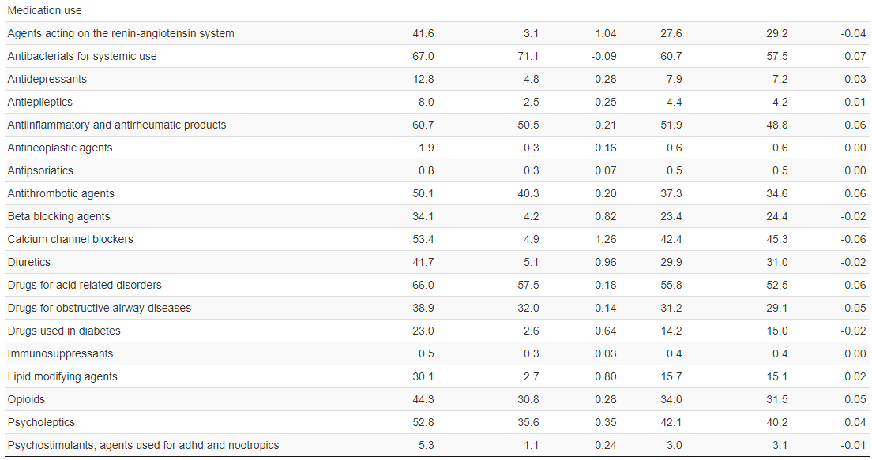
Population characteristics(colon)

Slide 16
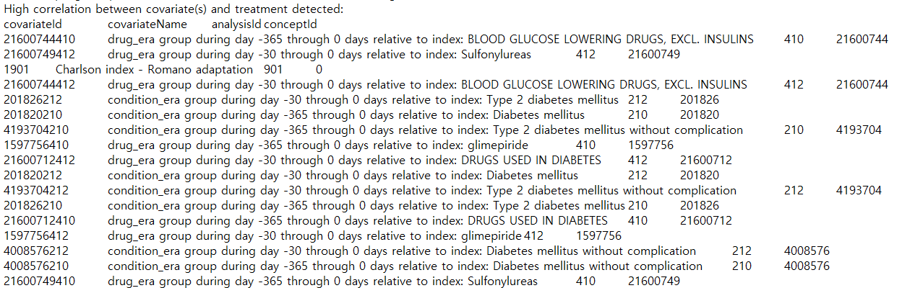
metformin결과
High correlation error

Slide 17
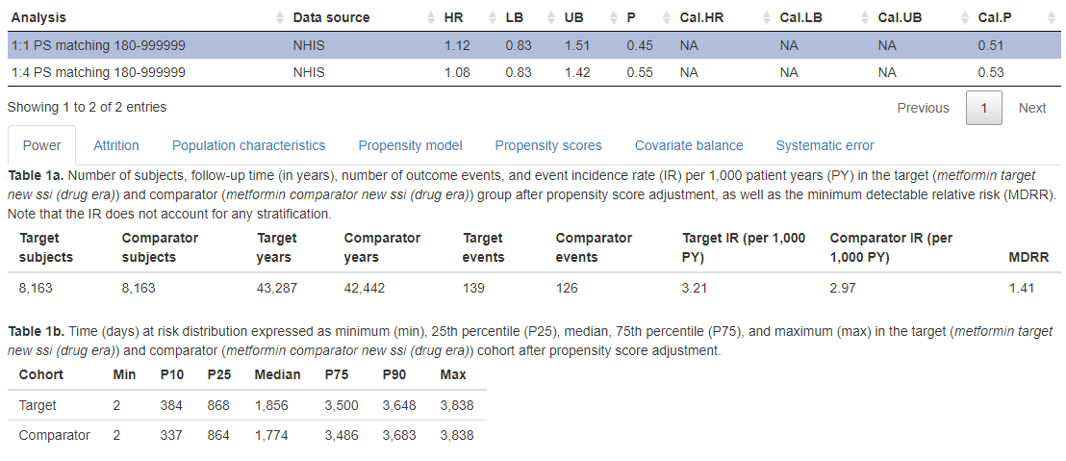
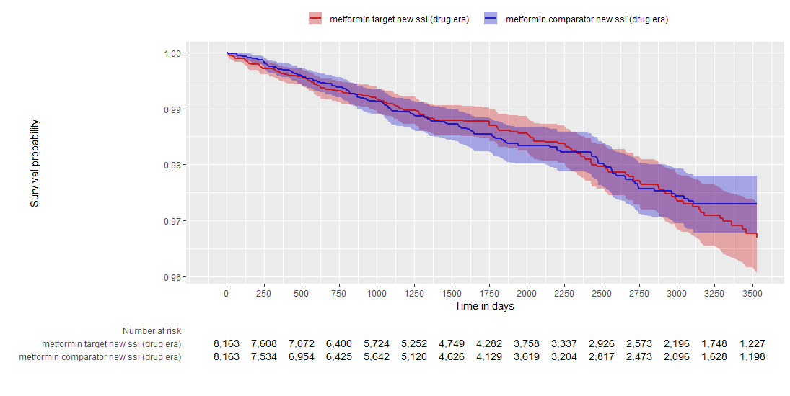
Metformin결과 - stomach

Slide 18
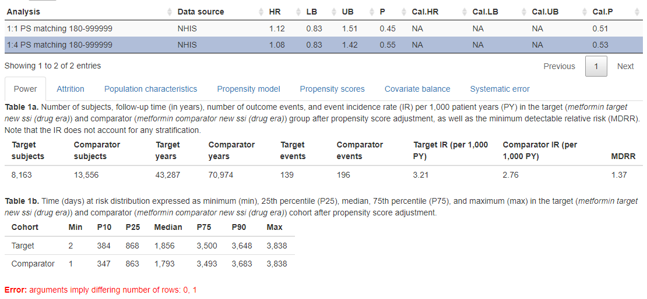
Metformin결과 - stomach

Slide 19
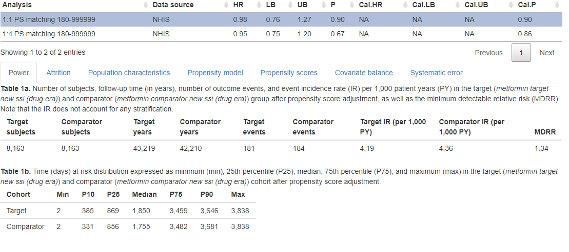
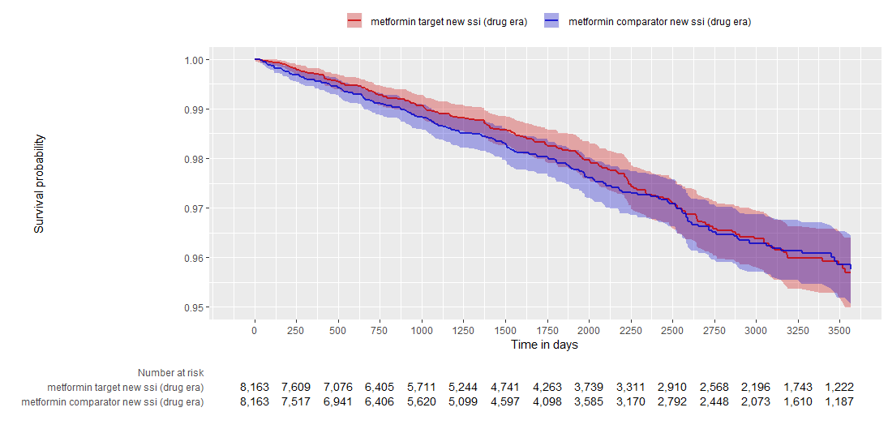
Metformin결과 - colon

Slide 20
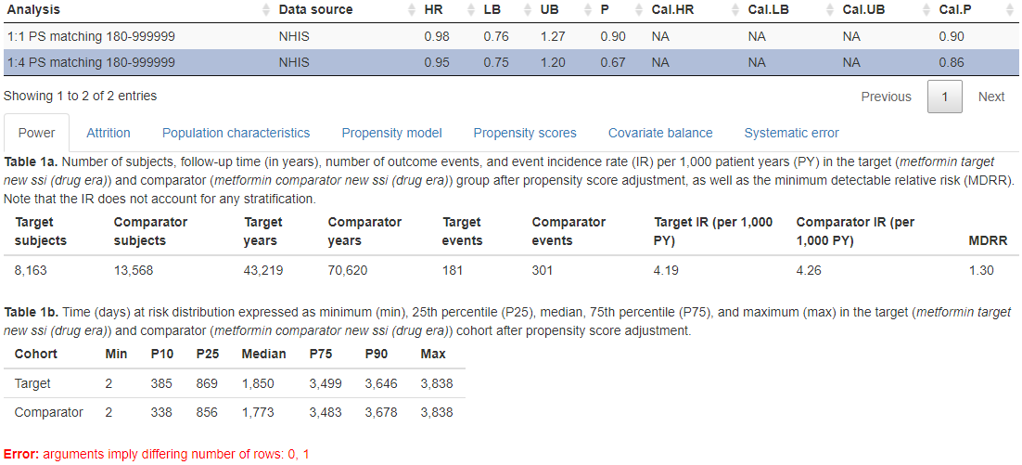
Metformin결과 - colon

Slide 21
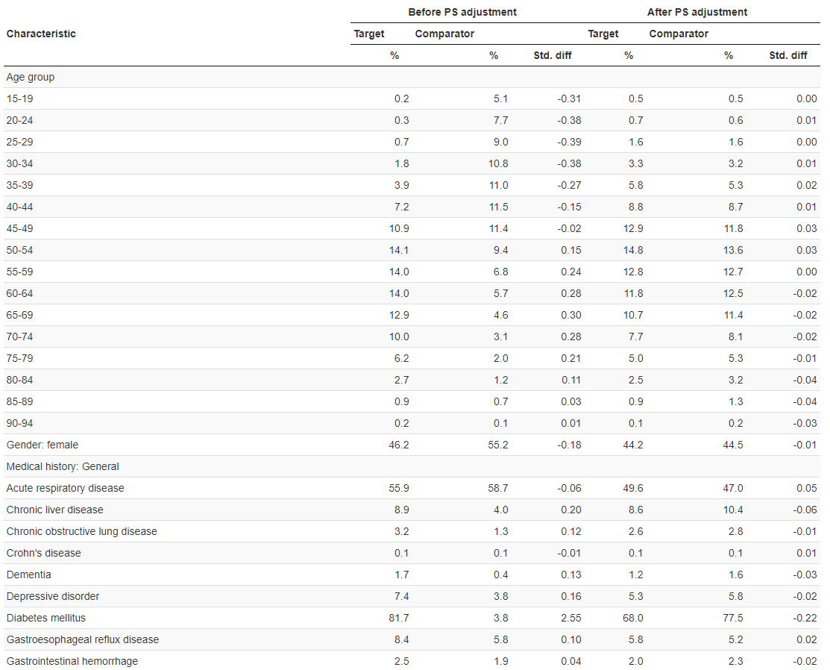
Population characteristics(stomach)

Slide 22
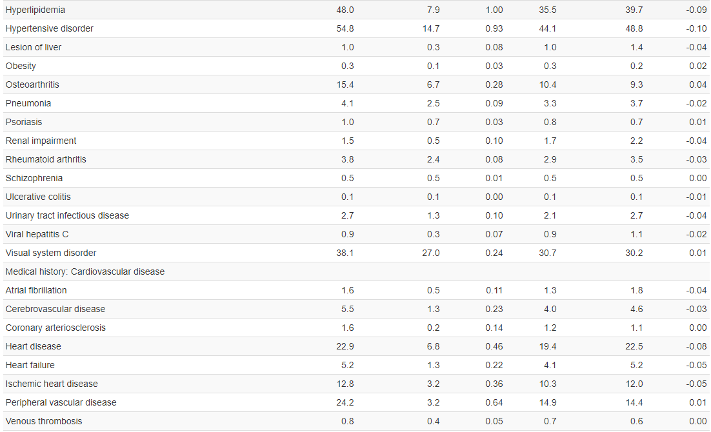
Population characteristics(stomach)

Slide 23
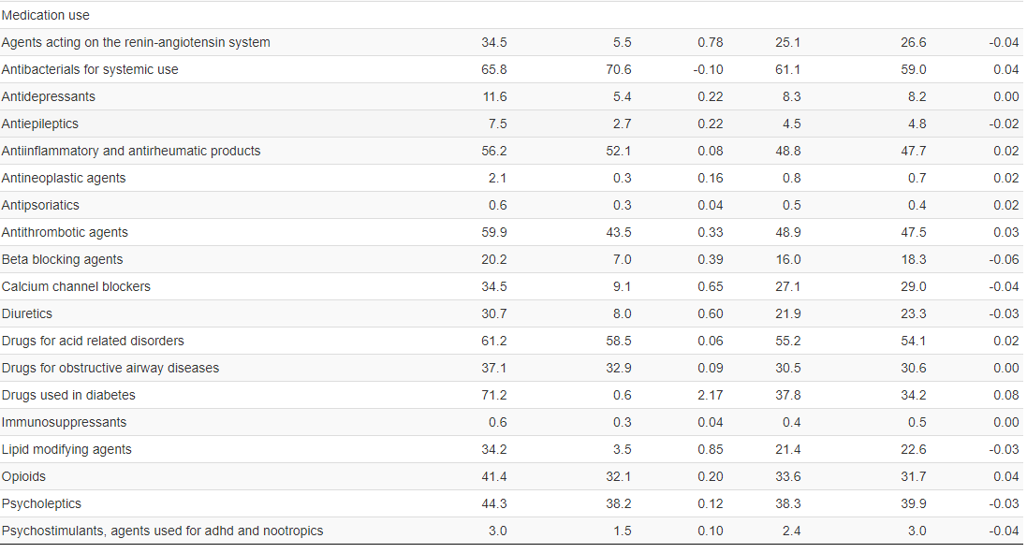
Population characteristics(stomach)

Slide 24
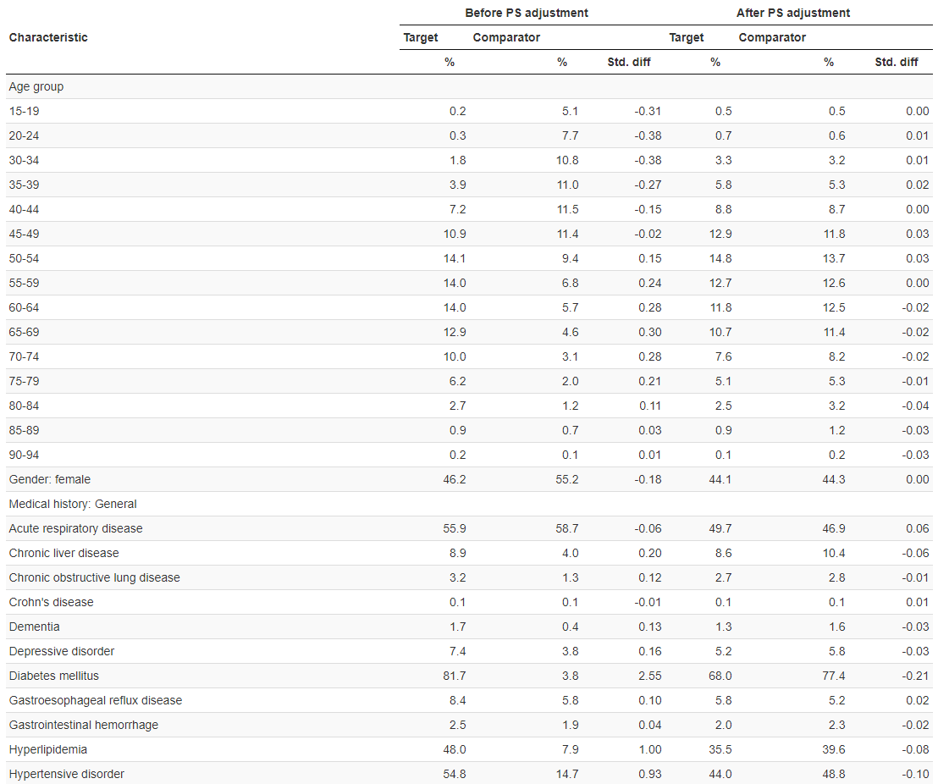
Population characteristics(colon)

Slide 25
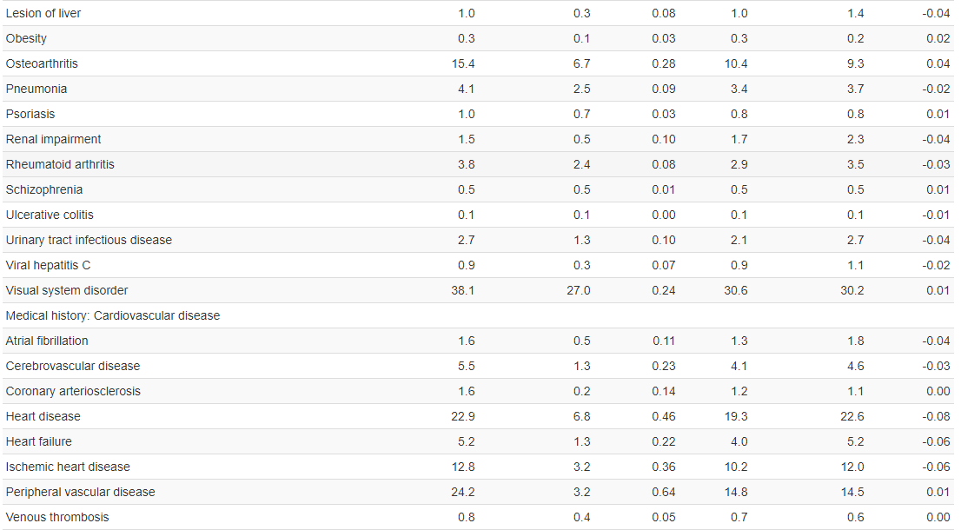
Population characteristics(colon)

Slide 26
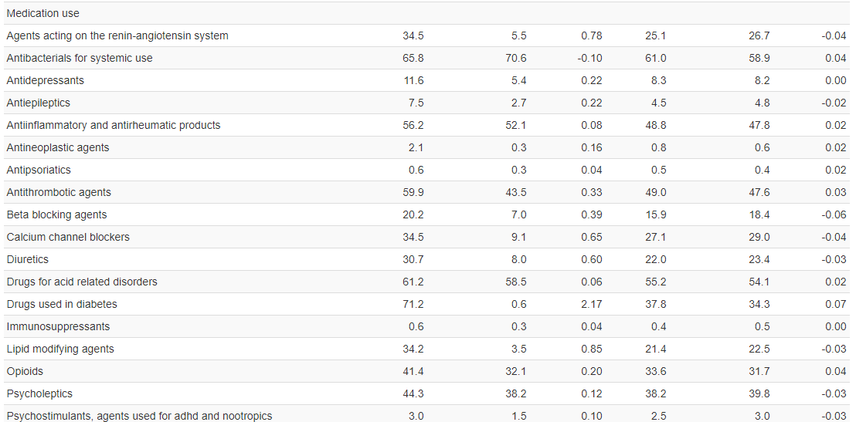
Population characteristics(colon)

Slide 27
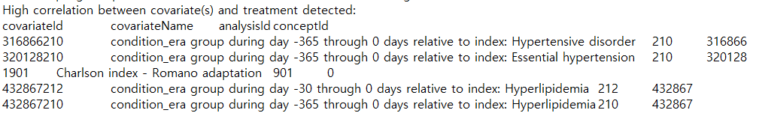
Statin 결과
High correlation error

Slide 28
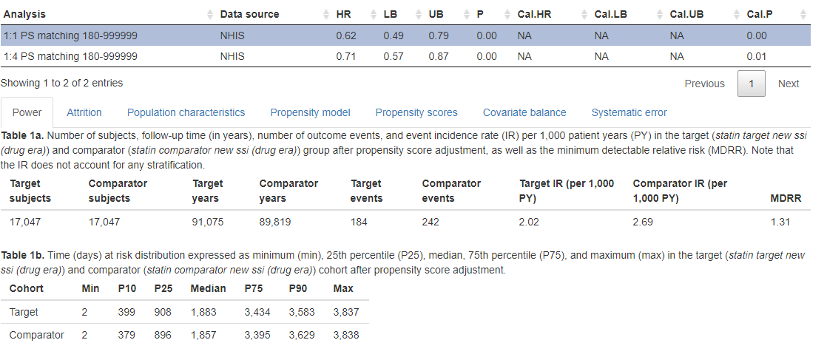
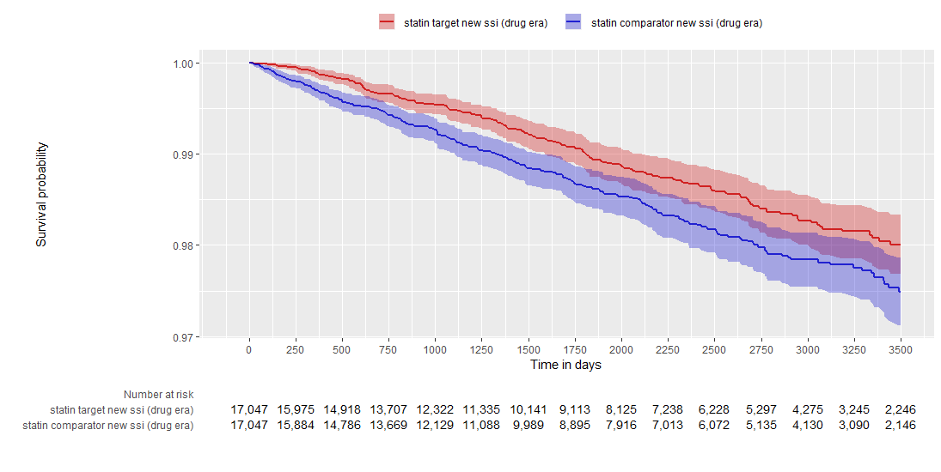
Statin 결과 - stomach

Slide 29
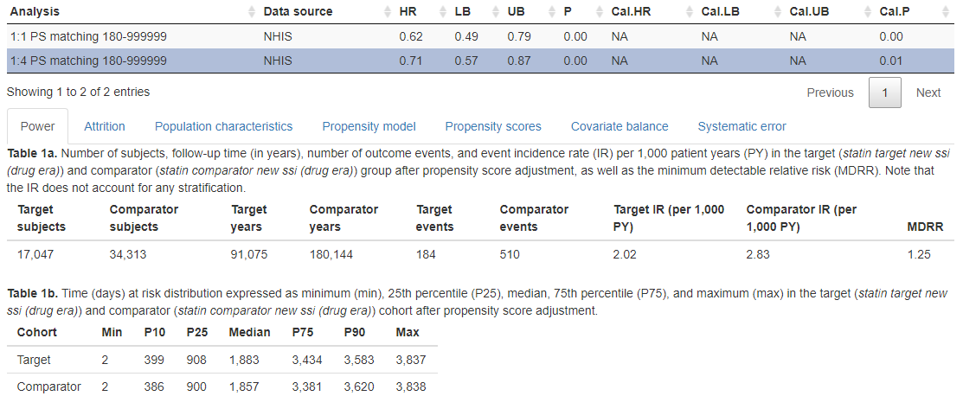
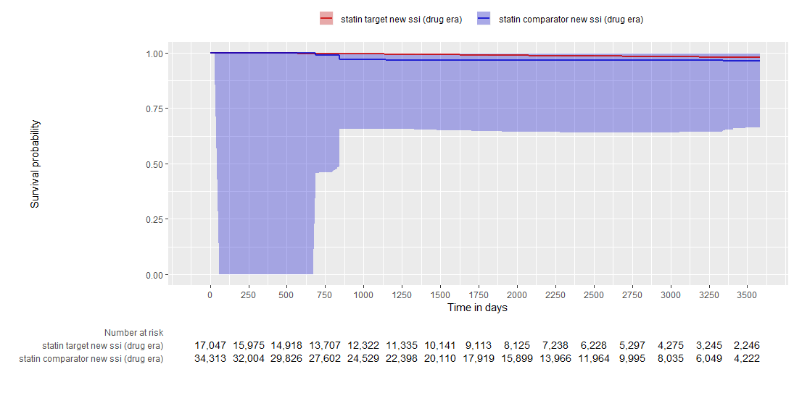
Statin 결과 - stomach

Slide 30
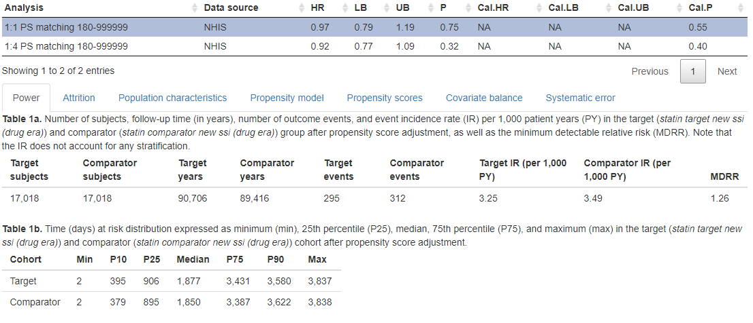
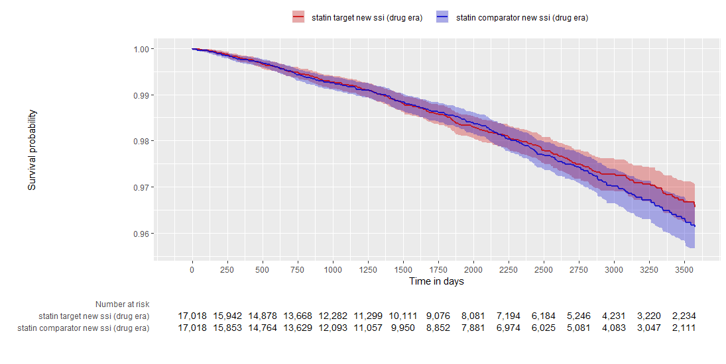
Statin 결과 - colon

Slide 31
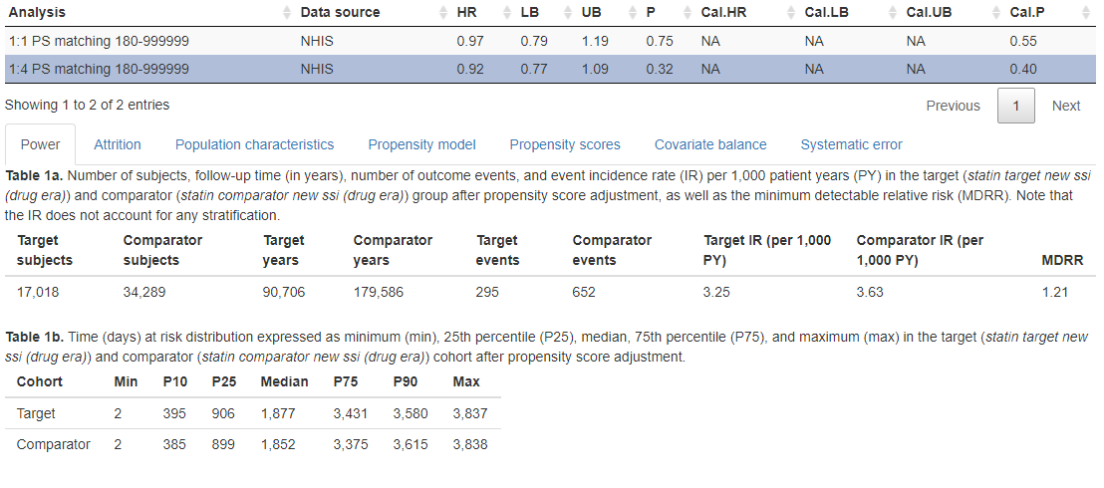
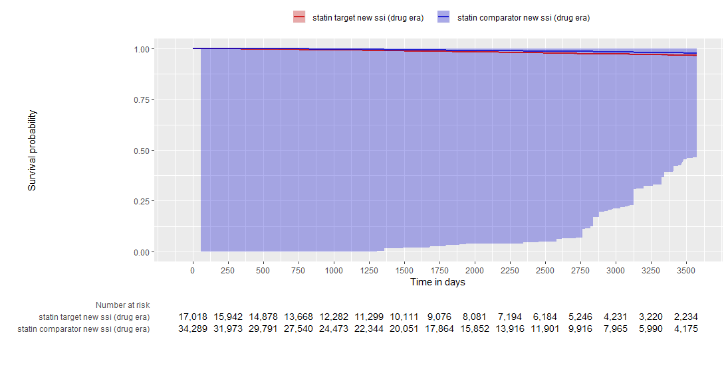
Statin 결과 - colon

Slide 32
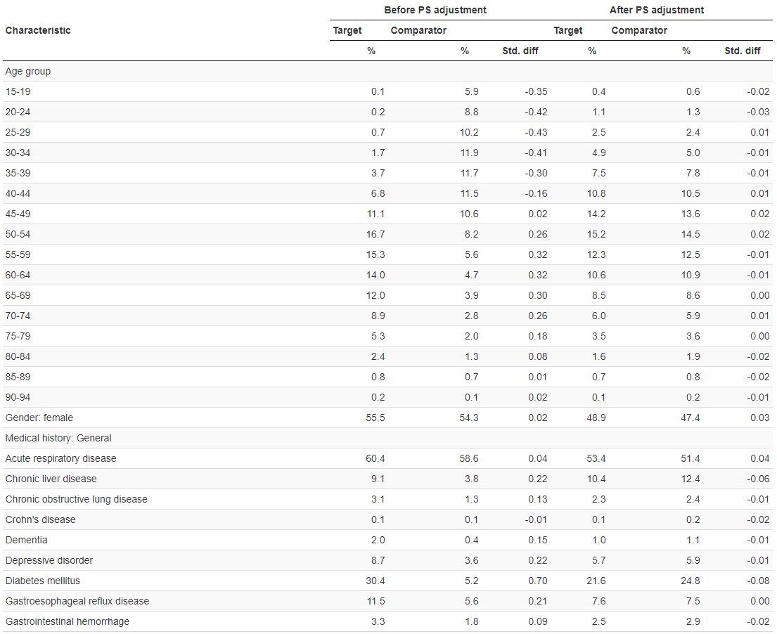
Population characteristics(stomach)

Slide 33
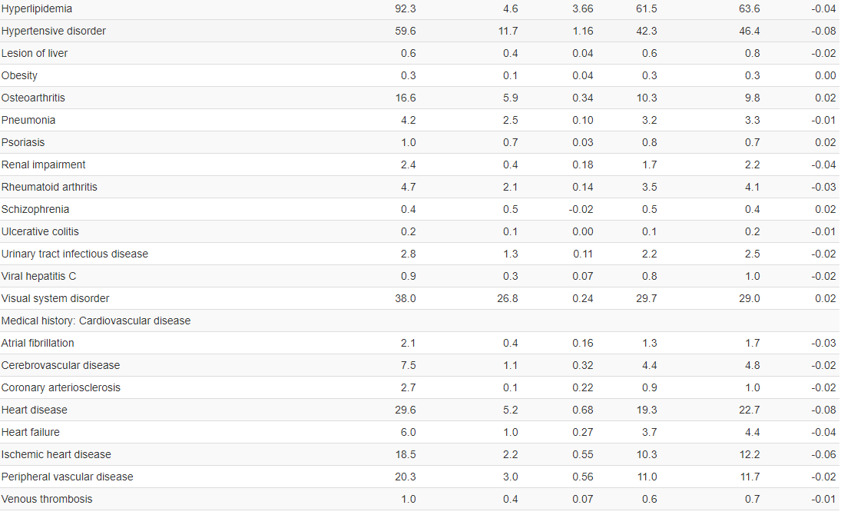
Population characteristics(stomach)

Slide 34
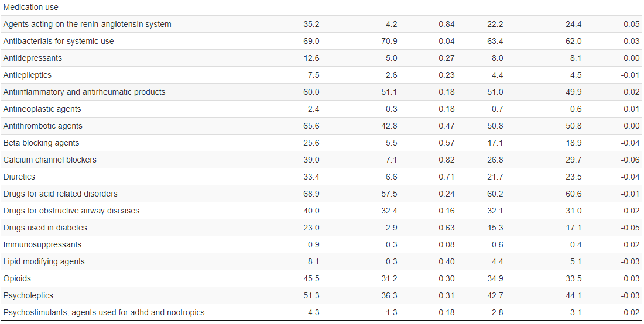
Population characteristics(stomach)

Slide 35

Population characteristics(colon)

Slide 36
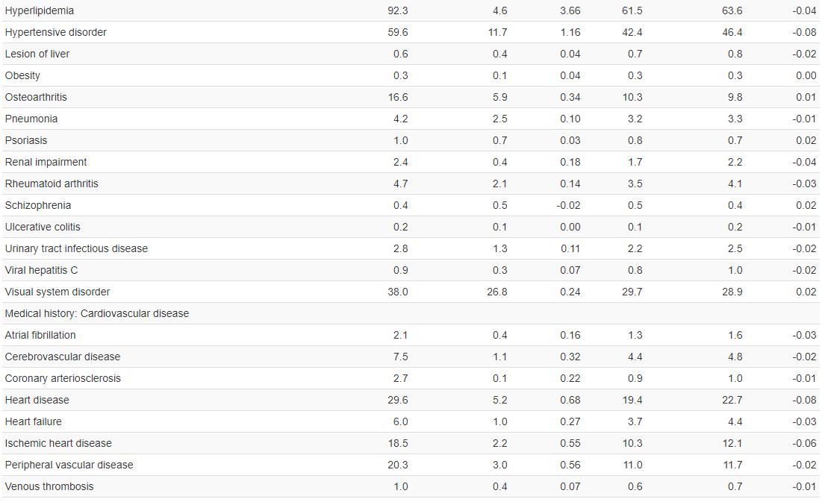
Population characteristics(colon)

Slide 37
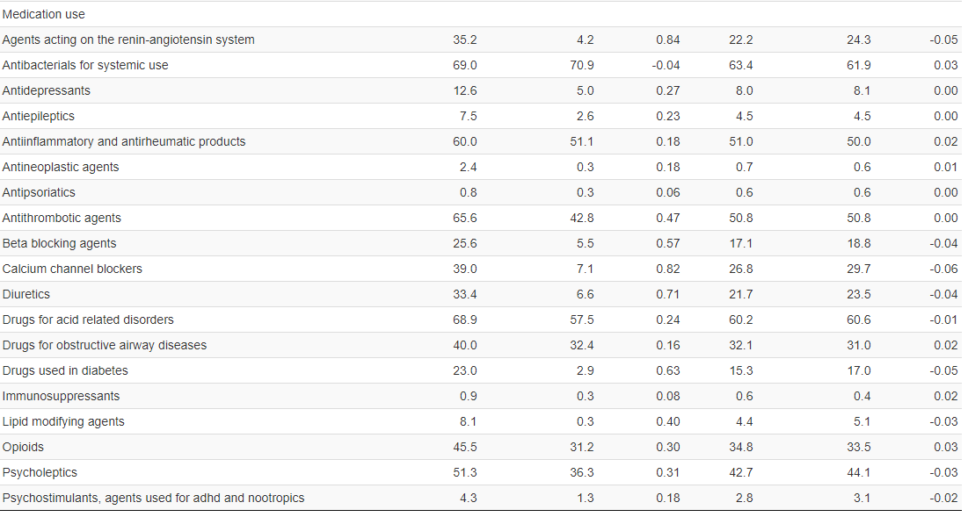
Population characteristics(colon)

Slide 38
Aspirin, metformin, statin vs any drug
Target – persistence window 30 days
High correlation설정 - no

Slide 39
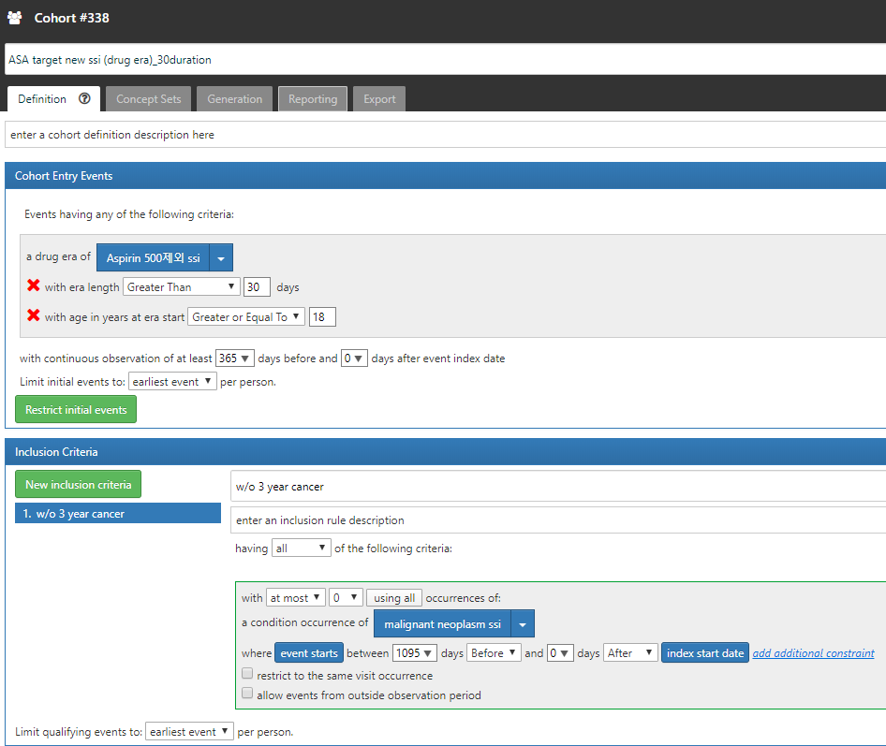
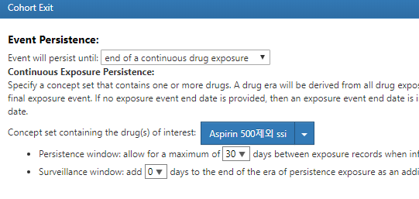
Target cohort

Slide 40
Comparator cohort

Slide 41
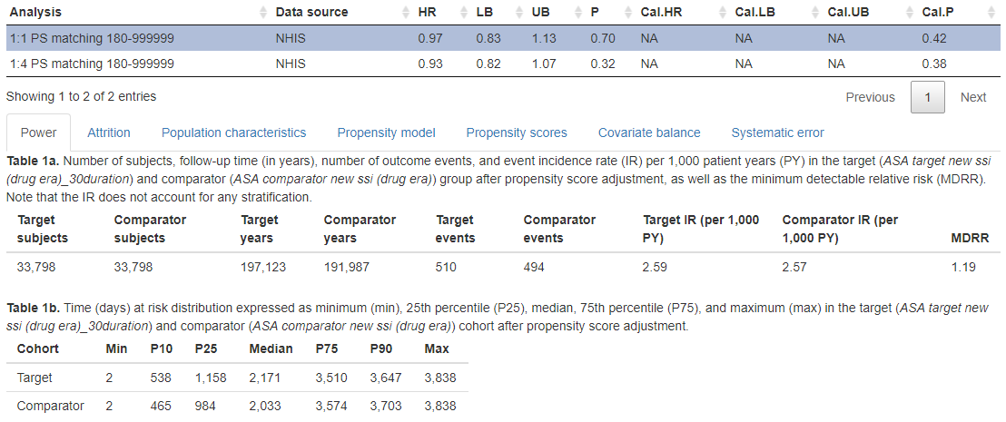
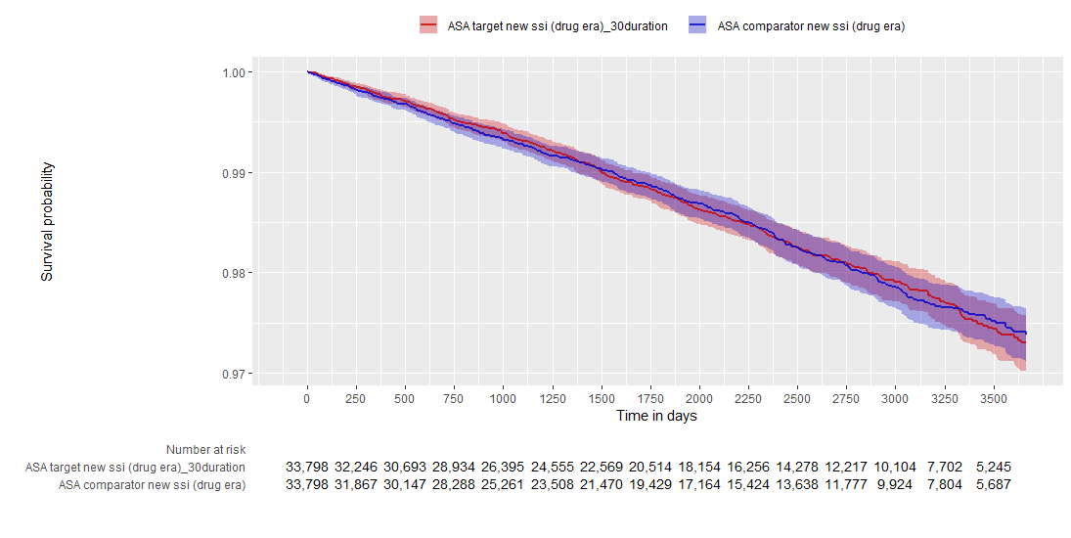
Aspirin 결과 – stomach

Slide 42
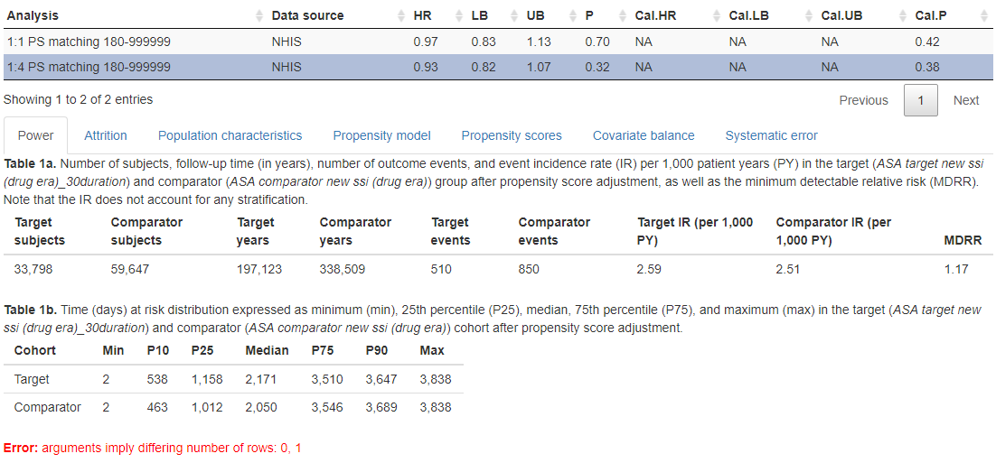
Aspirin 결과 – stomach

Slide 43
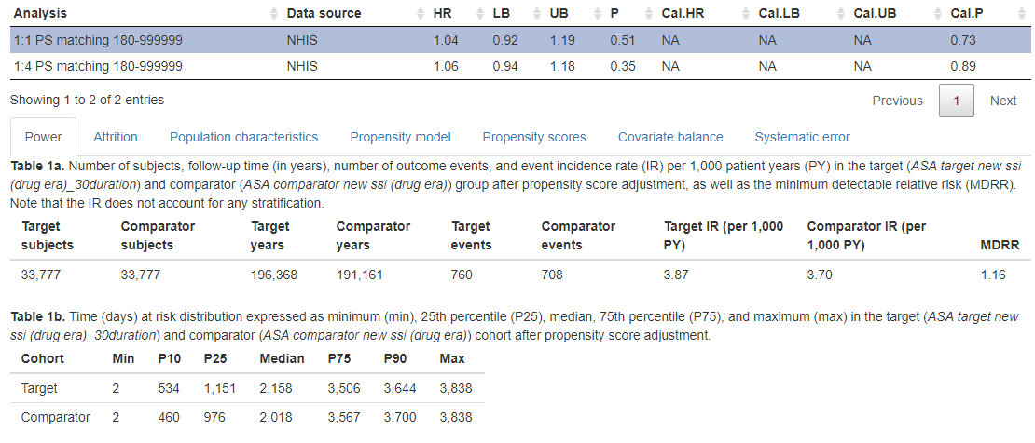

Aspirin 결과 – colon

Slide 44

Aspirin 결과 – colon

Slide 45

Population characteristics(stomach)

Slide 46

Population characteristics(stomach)

Slide 47

Population characteristics(stomach)

Slide 48

Population characteristics(colon)

Slide 49

Population characteristics(colon)

Slide 50

Population characteristics(colon)

Slide 51


Metformin결과 – stomach

Slide 52

Metformin결과 – stomach

Slide 53


Metformin결과 – colon

Slide 54

Metformin결과 – colon

Slide 55

Population characteristics(stomach)

Slide 56

Population characteristics(stomach)

Slide 57

Population characteristics(stomach)

Slide 58

Population characteristics(colon)

Slide 59

Population characteristics(colon)

Slide 60

Population characteristics(colon)

Slide 61


Statin 결과 – stomach

Slide 62


Statin 결과 – stomach

Slide 63


Statin 결과 – colon

Slide 64


Statin 결과 – colon

Slide 65

Population characteristics(stomach)

Slide 66

Population characteristics(stomach)

Slide 67

Population characteristics(stomach)

Slide 68

Population characteristics(colon)

Slide 69

Population characteristics(colon)

Slide 70

Population characteristics(colon)

Slide 71
Aspirin, metformin, statin vs DM med under DM

Slide 72


Target cohort

Slide 73



Comparator cohort

Slide 74


Aspirin 결과 – stomach

Slide 75


Aspirin 결과 – colon

Slide 76

Population characteristics(stomach)

Slide 77

Population characteristics(stomach)

Slide 78

Population characteristics(stomach)

Slide 79

Population characteristics(colon)

Slide 80

Population characteristics(colon)

Slide 81

Population characteristics(colon)

Slide 82
statin결과
High correlation error

Slide 83


Statin결과 -stomach

Slide 84


Statin결과 - colon

Slide 85

Population characteristics(stomach)

Slide 86

Population characteristics(stomach)

Slide 87

Population characteristics(stomach)

Slide 88

Population characteristics(colon)

Slide 89

Population characteristics(colon)

Slide 90

Population characteristics(colon)

Slide 91


Metformin 결과 -stomach

Slide 92


Metformin 결과 - colon

Slide 93

Population characteristics(stomach)

Slide 94

Population characteristics(stomach)

Slide 95

Population characteristics(stomach)

Slide 96

Population characteristics(colon)

Slide 97

Population characteristics(colon)

Slide 98

Population characteristics(colon)

